Slide 1
Advanced Data Structure and Algorithms
Trees
Graphs
Hashing
Search trees, Indexing, and multiways trees
File Organization

Slide 2
UNIT 4 SEARCH TREES, INDEXING, MULTIWAY TREES

Slide 3
Contents
Symbol Table
Representation
Static & Dynamic tree table
Introduction to Dynamic Programming
Weight balanced tree
Optimal Binary Search Tree (OBST)
Height Balanced Tree- AVL tree.
Indexing and Multiway Trees
Indexing
B-Trees, B+Tree, Trie Tree, Splay Tree, Red-Black Tree, K-dimensional tree
Heap Operations
Heap as Priority queue
Heap Sort

Slide 4
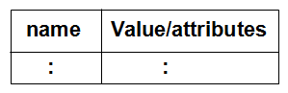
Symbol Table
Symbol table is an important data structure defined as the set of <Name, Value> pairs.
Operations or Functions of symbol table :
create() : symbol_table
destroy() : symbol_table
enter (name, value) : pointer to an entry
find (name, table) : pointer to an entry
set_attributes (*entry, attributes)
get_attributes (*entry) : attributes

Slide 5
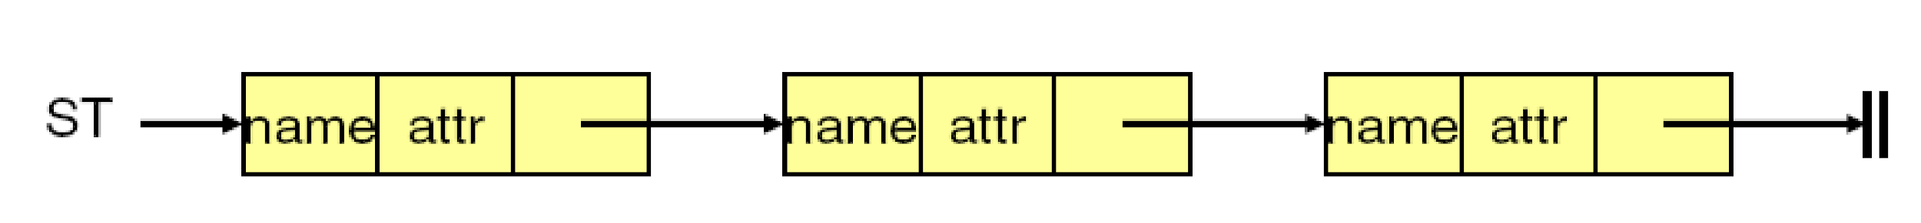
Symbol Table – Implementation techniques
Basic Operations : enter() and find()
Considerations:
Number of names
Storage space
Retrieval time
Organizations:
Unordered List - (linked list/array)
Ordered List – Binary search on arrays
Binary Search Trees
Hash Tables – Most common approach (constant time)

Slide 6
Use of symbol table
A data structure used by a language translator such as a compiler or interpreter.
Where, each symbol in a program's source code is associated with information relating to its –
Declaration
Scope or appearance in the source
Store information about the occurrence of various entities such as variable names, function names, objects, classes, interfaces, etc.
COMPILER
Source Program
Target Program
Errors

Slide 7
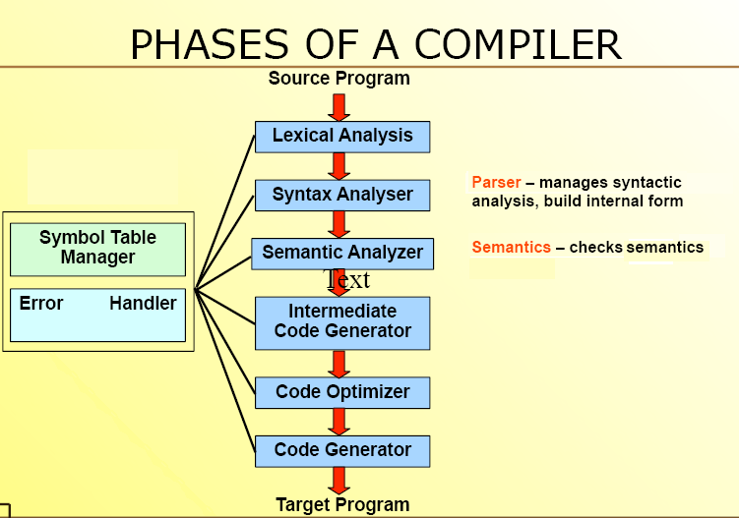

Slide 8
Lexical Analyzer
Lexical Analyzer converts sequence of characters into a sequence of tokens.
A token describes a pattern of characters having same meaning in the source program.
(such as identifiers, operators, keywords, numbers, delimeters and so on)
Puts information about identifiers into the symbol table.
Ex: newval = oldval + 12 → tokens:
newval identifier
= assignment operator
oldval identifier
+ add operator
12 a number

Slide 9
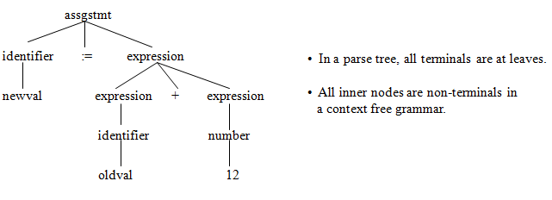
Syntax Analyzer
A Syntax Analyzer creates the syntactic structure (generally a parse tree) of the given program.
A syntax analyzer is also called as a parser.
A parse tree describes a syntactic structure.

Slide 10
Semantic Analyzer
A semantic analyzer checks the source program for semantic errors and collects the type information for the code generation.
Type-checking is an important part of semantic analyzer.
Ex:
newval := oldval + 12
The type of the identifier newval must match with type of the expression (oldval+12)

Slide 11
Intermediate Code Generation
A compiler may produce an explicit intermediate codes representing the source program.
These intermediate codes are generally machine (architecture independent).
Ex:
newval := oldval * fact + 1
id1 := id2 * id3 + 1
MULT id2, id3, temp1
ADD temp1, #1, temp2
MOV temp2, id1

Slide 12
Code Optimizer (for Intermediate Code Generator)
The code optimizer optimizes the code produced by the intermediate code generator in the terms of time and space.
Ex:
MULT id2,id3,temp1
ADD temp1,#1,id1

Slide 13
Code Generator
Produces the target language in a specific architecture.
The target program is normally is a relocatable object file containing the machine codes.
Ex:
MOVE id2,R1
MULT id3,R1
ADD #1,R1
MOVE R1,id1

Slide 14
Symbol tables
REPOSITORY of all information within a compiler. All parts of a compiler communicate thru this table and access the data-symbols.
Symbol Table is a “scratch pad” where the compiler keeps information about the “objects” in a program
Variables (storage areas)
Functions, procedures
Enables compiler to do type checking and determine/control scope of a variable

Slide 15
Symbol Table types
Static symbol table
Stores the fixed amount of information.
No insertion and deletion of any entry.
Example – OBST with fixed set of identifiers, to built minimum cost tree.
Huffman code can also be implemented using static symbol table
Dynamic
Stores the dynamic information.
Entries are constantly changing with frequent insertions and deletions of nodes.
Example – AVL tree i.e. height-balance tree.
Used to implement static and/or dynamic data structures.

Slide 16
OBST – Optimal BST (Need)
Symbol tables are used to store information or implement any data structures.
For BST-
Searching – The arrangement of nodes affect searching time.
Arrange BST in some specific manner to achieve quick and efficient search of any node.
Example – Consider 3 nodes say A,B,C ( 6 different ways to create a tree )

Slide 17
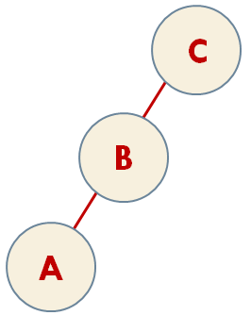
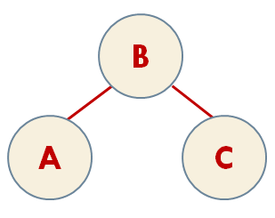
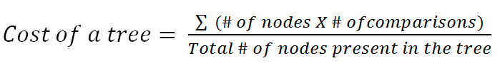
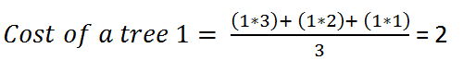
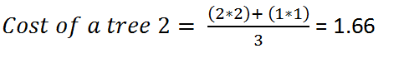
Optimal BST ?
Tree 1
Tree 2
Node | # comparisons
A | 3
B | 2
C | 1
Node | # comparisons
A, C | 2
B | 1
Optimal
What about unsuccessful searches ?

Slide 18
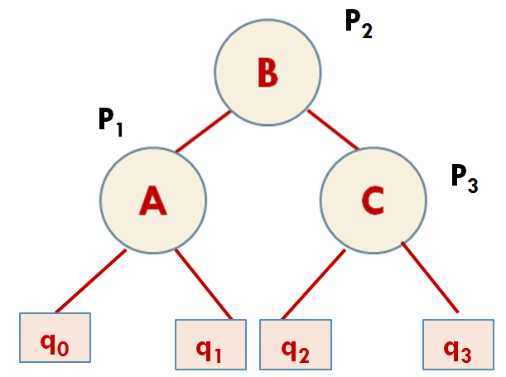
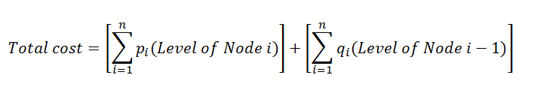
Unsuccessful searches; optimality, and OBST
P1, P2, P3 are the probabilities of successful searches.
q0, q1, q2, q3 are the probabilities of unsuccessful searches.
Assume all probabilities as 1/7

Slide 19
Optimal Binary Search Tree
OBST is one special kind of advanced tree.
It focus on how to reduce the searching cost of the BST.
It needs calculation to record probabilities, weight, cost, and root.
Example – Dictionary in the form of BST
Aim : Make this BST efficient by arranging frequently used words nearer to the root and less frequently used words away from the root. OR
Element having more probability of appearance should be placed nearer to the root and the Element having lesser probability should be placed away from the root.

Slide 20
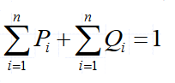
Optimal Binary Search Tree
n identifiers:a₁<a₂<a₃< …. <a_{n}
P_{i} ,1≤i ≤ n : the probability that a_{i} is searched. (successful search)
Q_{i} , 0 ≤ i ≤ n: the probability that x is searched; (unsuccessful search)
where a_{i} < x < a_{i+1} (a₀=-∞,a_{n+1}= ∞)

Slide 21
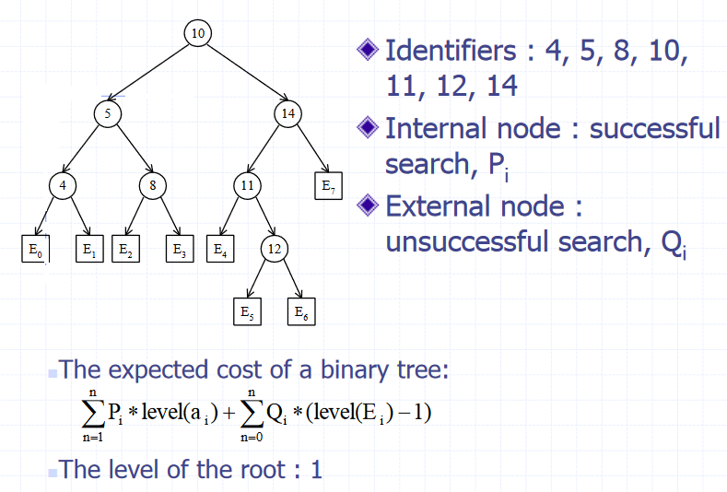
Optimal Binary Search Tree

Slide 22
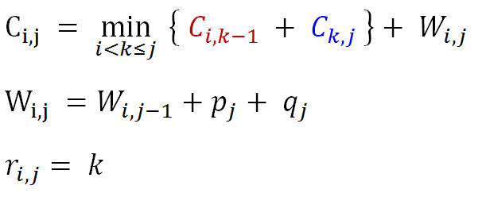
Optimal Binary Search Tree Dynamic Programming Approach
Notations:
T_{ij} = OBST (a_{i+1}, …., a_{j})
C_{ij} = Cost of T_{ij}
W_{ij} = Weight of each of T_{ij}
r_{ij} = Root values of T_{ij}
Formulae:

Slide 23
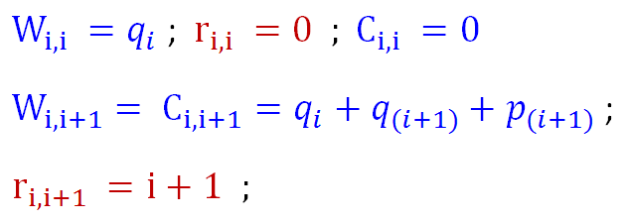
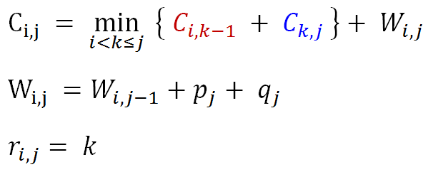
Optimal Binary Search Tree Dynamic Programming Approach
Example:
Consider n = 4 and keys = (do, if, int, while); p(1:4) = (3,3,1,1) and q(0:4) = (2,3,1,1,1). Construct the OBST.
Formulae:

Slide 24
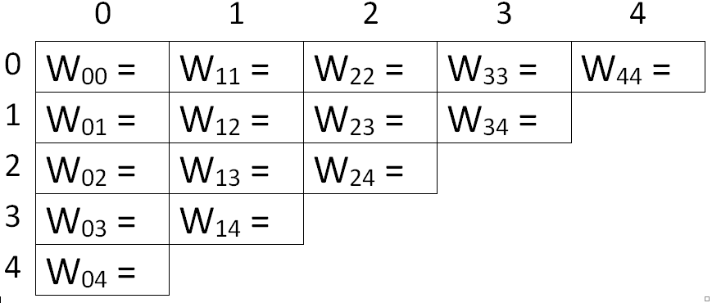
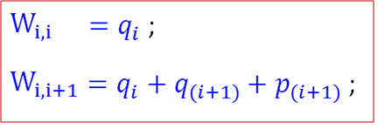
Optimal Binary Search Tree Dynamic Programming Approach
Consider n = 4 and keys = (do, if, int, while);
p(1:4) = (3,3,1,1) & q(0:4) = (2,3,1,1,1). Construct the OBST.
i
j-1

Slide 25
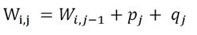
Optimal Binary Search Tree Dynamic Programming Approach
Consider n = 4 and keys = (do, if, int, while);
p(1:4) = (3,3,1,1) & q(0:4) = (2,3,1,1,1).
i=0; | i=0; j - i = 1 | i=3; j - i = 1 | i=2; j - i = 2
W₀₀ = q₀ = 2 | W₀₁ = q₀ + q₁ + p₁ = 2 + 3 + 3 = 8 | W₃₄ = q₃ + q₄ + p₄ = 1 + 1 + 1 = 3 | W₂₄ = W₂₃+ p₄+ q₄ = 3 + 1 + 1 = 5
W₁₁ = q₁ = 3 | i=1; j - i = 1 | i=0; j - i = 2 | i=0; j - i = 3
W₂₂ = q₂ = 1 | W₁₂ = q₁ + q₂ + p₂ = 3 + 1 + 3 = 7 | W₀₂ = W₀₁ + p₂ + q₂ = 8 + 3 + 1 = 12 | W₀₃ = W₀₂+p₃ + q₃ = 12+1 +1 = 14
W₃₃ = q₃ = 1 | i=2; j - i = 1 | i=1; j - i = 2 | i=1; j - i = 3 W₁₄ = 11
W₄₄ = q₄ = 1 | W₂₃ = q₂ + q₃ + p₃ = 1 + 1 + 1 = 3 | W₁₃ = W₁₂ + p₃ + q₃ = 7 + 1 + 1 = 9 | i=0; j - i = 4 W₀₄ = 16

Slide 26
Optimal Binary Search Tree Dynamic Programming Approach
Consider n = 4 and keys = (do, if, int, while);
p(1:4) = (3,3,1,1) & q(0:4) = (2,3,1,1,1).
i=0; | i=0; j - i = 1 | i=3; j - i = 1 | i=2; j - i = 2
W₀₀ = q₀ = 2 | W₀₁ = q₀ + q₁ + p₁ = 2 + 3 + 3 = 8 | W₃₄ = q₃ + q₄ + p₄ = 1 + 1 + 1 = 3 | W₂₄ = W₂₃+ p₄+ q₄ = 3 + 1 + 1 = 5
W₁₁ = q₁ = 3 | i=1; j - i = 1 | i=0; j - i = 2 | i=0; j - i = 3
W₂₂ = q₂ = 1 | W₁₂ = q₁ + q₂ + p₂ = 3 + 1 + 3 = 7 | W₀₂ = W₀₁ + p₂ + q₂ = 8 + 3 + 1 = 12 | W₀₃ = W₀₂+p₃ + q₃ = 12+1 +1 = 14
W₃₃ = q₃ = 1 | i=2; j - i = 1 | i=1; j - i = 2 | i=1; j - i = 3 W₁₄ = 11
W₄₄ = q₄ = 1 | W₂₃ = q₂ + q₃ + p₃ = 1 + 1 + 1 = 3 | W₁₃ = W₁₂ + p₃ + q₃ = 7 + 1 + 1 = 9 | i=0; j - i = 4 W₀₄ = 16

Slide 27
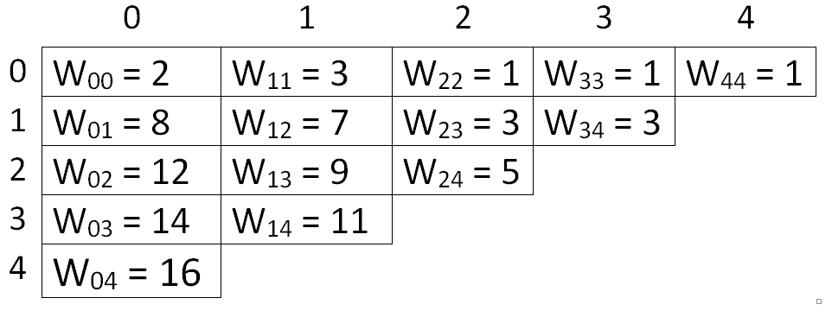
Optimal Binary Search Tree Dynamic Programming Approach
Consider n = 4 and keys = (do, if, int, while);
p(1:4) = (3,3,1,1) & q(0:4) = (2,3,1,1,1). Construct the OBST.
i
j-1
Calculated W_{ij}

Slide 28
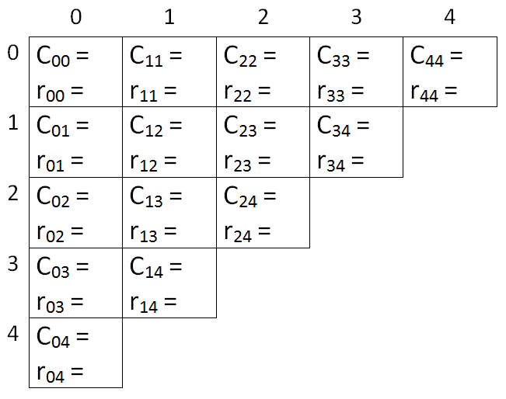
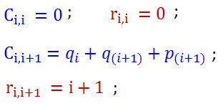
Optimal Binary Search Tree Computer C and r
Keys = (do, if, int, while); p(1:4) = (3,3,1,1) & q(0:4) = (2,3,1,1,1).
i
j-1

Slide 29
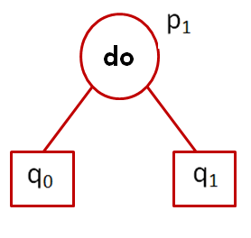
Optimal Binary Search Tree Computer C and r
Keys = (do, if, int, while);
p(1:4) = (3,3,1,1) & q(0:4) = (2,3,1,1,1).
Cij; where, j-i = 0 |  | Cij; where, j-i ≥ 2
C₀₀ = C₁₁ = C₂₂ = C₃₃ = C₄₄ = 0 r₀₀ = r₁₁ = r₂₂ = r₃₃ = r₄₄ = 0 |  | C₀₂, C₀₃, C₀₄ ; C₁₂, C₁₄ ; C₂₄
Cij; where, j-i = 1
C₀₁ = q₀+q₁+p₁ = 2+3+3 = 8 | C₃₄ = q₃+q₄+p₄ = 1+1+1=3
C₁₂ = q₁+q₂+p₂ = 3+1+3 = 7 | r₀₁ = 1 r₁₂ = 2
C₂₃ = q₂+q₃+p₃ = 1+1+1 = 3 | r₂₃ = 3 r₃₄ = 4

Slide 30
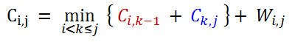
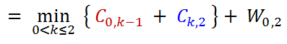
Optimal Binary Search Tree Computer C and r
Keys = (do, if, int, while);
p(1:4) = (3,3,1,1) & q(0:4) = (2,3,1,1,1).
Cij; where, j-i = 0 |  | Cij; where, j-i ≥ 2
C₀₀ = C₁₁ = C₂₂ = C₃₃ = C₄₄ = 0 r₀₀ = r₁₁ = r₂₂ = r₃₃ = r₄₄ = 0 |  | C₀₂
Cij; where, j-i = 1 |  | k is between 0 & 2
C₀₁ = 8; r₀₁ = 1 | C₂₃ = 3; r₂₃ = 3 | i=0; j = 2; k = 1 | i=0; j = 2; k = 2
C₁₂ = 7 ; r₁₂ = 2 | C₃₄ = 3; r₃₄ = 4 | C₀₂ = C₀₀ + C₁₂ = 0 + 7 = 7 | C₀₂ = C₀₁ + C₂₂ = 8 + 0 = 8
C₀₂, C₀₃, C₀₄ ; C₁₂, C₁₄ ; C₂₄ |  | C₀₂ = min { 7, 8 } + 12 = 19 r₀₂ = 1 ( as we get min value with k =1)

Slide 31
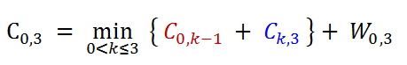
Optimal Binary Search Tree Computer C and r
Keys = (do, if, int, while); p(1:4) = (3,3,1,1) & q(0:4) = (2,3,1,1,1).
Cij; where, j-i ≥ 2
k is between 0 & 3
i=0; j = 3; k = 1 | i=0; j = 3; k = 2 | i=0; j = 3; k = 3
C₀₃= C₀₀ + C₁₃ = 0 + 12 = 12 | C₀₃ = C₀₁ + C₂₃ = 8 + 3 = 11 | C₀₃ = C₀₂ + C₃₃ = 19 + 0 = 19
C₀₃ = min { 12, 11, 19 } + 14 = 25 r₀₃ = 2 ( as we get min value with k = 2)

Slide 32
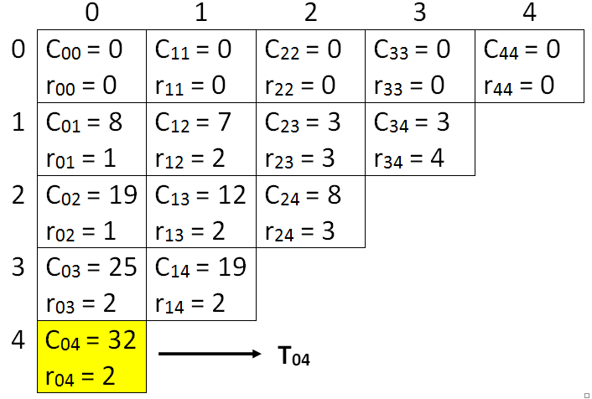
Optimal Binary Search Tree Dynamic Programming Approach
OBST for keys = (do, if, int, while);
Root of tree T₀₄ is r₀₄ = 2
Key with index 2 (if)
r_{ij} = k
r_{i,k-1} becomes left child
r_{k,j} becomes right child

Slide 33
Optimal Binary Search Tree Dynamic Programming Approach
OBST for keys = (do, if, int, while);
if
do
int
while

Slide 34
Balanced binary tree
The disadvantage of a BST - its height can be as large as N-1
The time needed to perform insertion and deletion and many other operations can be O(N) in the worst case.
We want a tree with small height.
Goal is to keep the height of a binary search tree O(log N)
Such trees are called balanced binary search trees.
Examples
AVL tree
Red-black tree

Slide 35
AVL - First dynamic balanced trees
AVL tree is a self-balancing BST, where the difference between heights of left and right subtrees cannot be more than one for all nodes.
Named after their inventors, Adelson-Velskii and Landis.
Good for lookup-intensive applications
Searching of desired node is faster due to balancing of tree height.
Definition-
An AVL tree is a balanced binary search tree.
In an AVL tree, balance factor of every node is either -1, 0 or +1.
Every subtree is an AVL tree.
Balance Factor = Height of Left Subtree – Height of Right Subtree

Slide 36
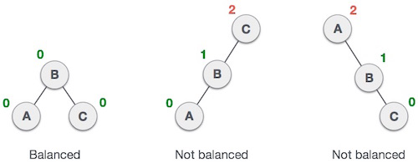
Height of BST

Slide 37
Insertion in AVL tree
STEPS-
Insert the element in the AVL tree in the same way the insertion is performed in BST.
After insertion, check the balance factor of each node of the resulting tree.
CASES
Balance factor of each node IS {-1,0,1} | Balance factor of each node is NOT {-1,0,1}
The tree is considered to be balanced. | The tree is considered to be imbalanced.
Conclude the operation. | Perform the suitable ROTATION(s) to balance the tree.
Insert the next element if any. | After the tree is balanced, insert the next element if any.

Slide 38
Searching and Deletion in AVL tree
STEPS-
Searching is similar to searching in BST.
Deletion is also similar to searching in BST.
But after every deletion operation we need to check with the Balance Factor condition.
If the tree is balanced after deletion go for next operation;
otherwise perform suitable rotation to make the tree Balanced.

Slide 39
AVL Rotations
Rotation is the process of moving nodes either to left or to right to make the tree balanced.
Rotation types:
Single Rotations
Left Rotation (LL Rotation)
Right Rotation (RR Rotation)
Double Rotations
Left Right Rotation (LR Rotation)
Right Left Rotation (RL Rotation)

Slide 40
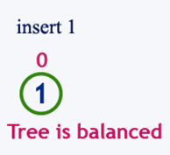
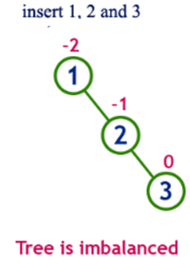
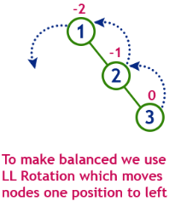
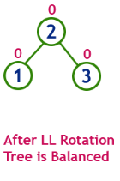
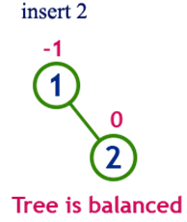
LL Rotations – Single Left Rotation
In LL Rotation, every node moves one position to left from the current position.
Tree is unbalanced because of adding right child in the right subtree of an unbalanced node.

Slide 41
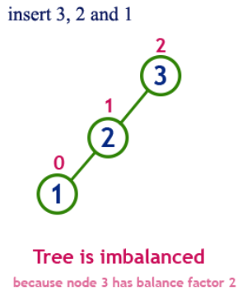
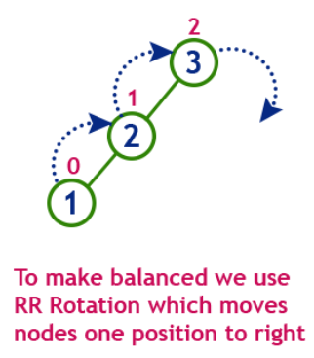
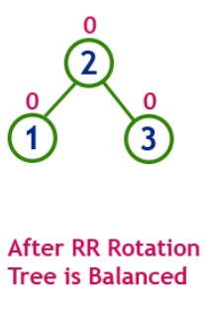
RR Rotations – Single Right Rotation
In RR Rotation, every node moves one position to right from the current position.
Tree is unbalanced because of adding left child in the left subtree of an unbalanced node.

Slide 42
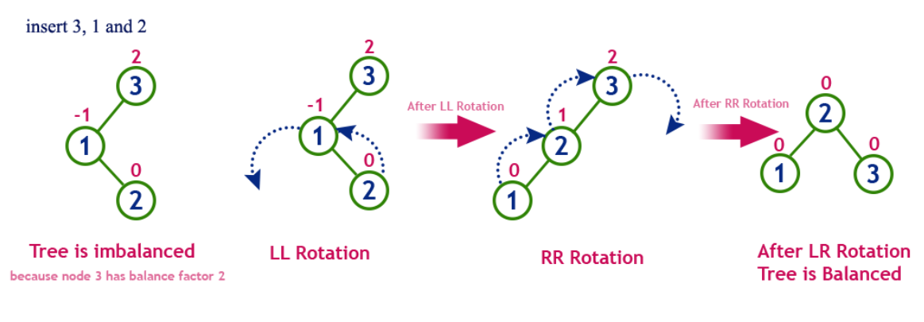
LR Rotations – Double Rotations
The LR Rotation is sequence of single left rotation followed by single right rotation.
Tree is unbalanced because of adding right child in the left subtree of an unbalanced node.

Slide 43
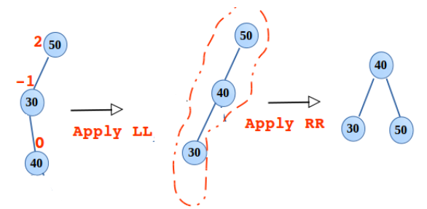
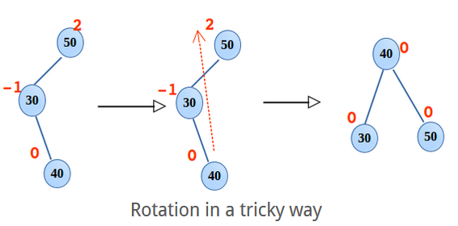
LR Rotations – Double Rotations

Slide 44
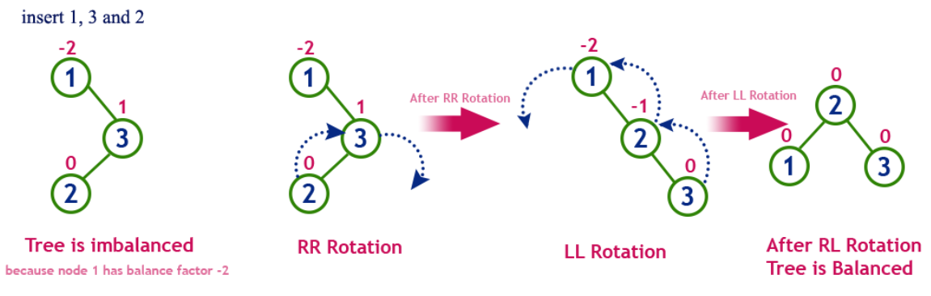
RL Rotations – Double Rotations
The RL Rotation is sequence of single right rotation followed by single left rotation.
Tree is unbalanced because of adding left child in the right subtree of an unbalanced node.

Slide 45
RL Rotations – Double Rotations
The RL Rotation is sequence of single right rotation followed by single left rotation.
Tree is unbalanced because of adding left child in the right subtree of an unbalanced node.

Slide 46
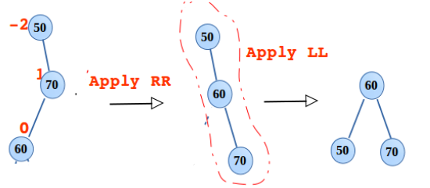
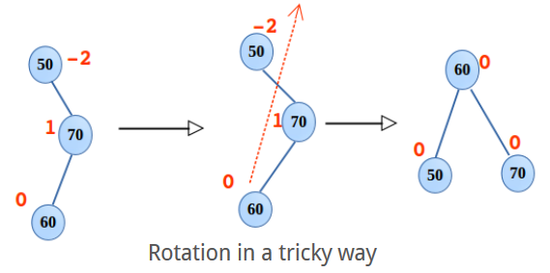
RL Rotations – Double Rotations

Slide 47
Rotations - Possibilities
15
Add 16
15
5
20
5
20
17
25
17
25
Balanced Tree
16
The pattern of adding 16 is RLL
But consider only 3 nodes for rotation including the unbalanced node.

Slide 48
AVL Animation
https://www.cs.usfca.edu/~galles/visualization/AVLtree.html

Slide 49
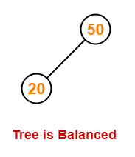
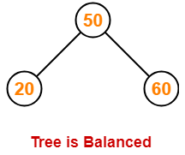
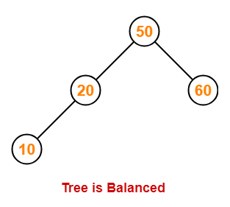
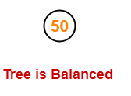
AVL Examples
Construct AVL Tree for the following sequence - 50, 20, 60, 10, 8, 15, 32, 46, 11, 48
Insert 50
Insert 20
Insert 60
Insert 10

Slide 50
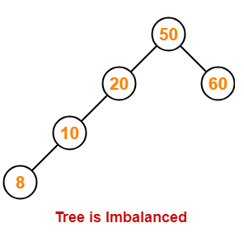
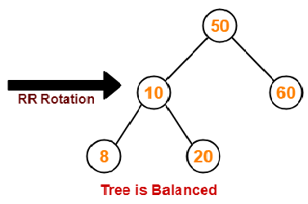
AVL Examples
Construct AVL Tree for the following sequence - 50, 20, 60, 10, 8, 15, 32, 46, 11, 48
Insert 8

Slide 51
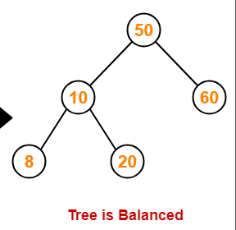
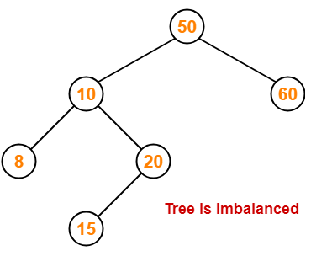


Construct AVL Tree for the following sequence - 50, 20, 60, 10, 8, 15, 32, 46, 11, 48
Insert 15

Slide 52


Construct AVL Tree for the following sequence - 50, 20, 60, 10, 8, 15, 32, 46, 11, 48
Insert 46 and 11
Insert 32

Slide 53

Construct AVL Tree for the following sequence - 50, 20, 60, 10, 8, 15, 32, 46, 11, 48
Insert 48

Slide 54


Construct AVL Tree for the following sequence - 50, 20, 60, 10, 8, 15, 32, 46, 11, 48

Slide 55
AVL Tree Example:
Insert 14, 17, 11, 7, 53, 4, 13 into an empty AVL tree
14
11
17
7
53
4
RR Rotation

Slide 56
AVL Tree Example:
Insert 14, 17, 11, 7, 53, 4, 13 into an empty AVL tree
14
7
17
4
11
53
13

Slide 57
AVL Tree Example:
Now insert 12
14
7
17
4
11
53
13
12
RL Rotation

Slide 58
AVL Tree Example:
Now insert 12
14
7
17
4
11
53
12
13

Slide 59
AVL Tree Example:
Now the AVL tree is balanced.
14
7
17
4
12
53
11
13

Slide 60
AVL Tree Example:
Now insert 8
14
7
17
4
12
53
11
13
8
RL Rotation

Slide 61
AVL Tree Example:
Now insert 8
14
7
17
4
11
53
8
12
13

Slide 62
AVL Tree Example:
Now the AVL tree is balanced.
14
11
17
7
12
53
4
8
13

Slide 63
AVL Tree Example:
Now remove 53
14
11
17
7
12
53
4
8
13

Slide 64
AVL Tree Example:
Now remove 53, unbalanced
14
11
17
7
12
4
8
13

Slide 65
AVL Tree Example:
Balanced! Remove 11
11
7
14
4
8
12
17
13

Slide 66
AVL Tree Example:
Remove 11, replace it with the largest in its left branch
8
7
14
4
12
17
13

Slide 67
AVL Tree Example:
Remove 8, unbalanced
7
4
14
12
17
13

Slide 68
AVL Tree Example:
Remove 8, unbalanced
7
4
12
14
13
17

Slide 69
AVL Tree Example:
Balanced!!
12
7
14
4
13
17

Slide 70
In Class Exercises
Build an AVL tree with the following values:
15, 20, 24, 10, 13, 7, 30, 36, 25

Slide 71
15, 20, 24, 10, 13, 7, 30, 36, 25
20
15
15
24
20
10
24
13
20
20
13
24
15
24
10
15
13
10

Slide 72
15, 20, 24, 10, 13, 7, 30, 36, 25
20
13
13
24
10
20
10
15
7
15
24
7
30
13
36
10
20
7
15
30
24
36

Slide 73
15, 20, 24, 10, 13, 7, 30, 36, 25
13
13
10
20
10
20
7
15
30
7
15
24
24
36
30
25
13
25
36
10
24
7
20
30
15
25
36

Slide 74
Remove 24 and 20 from the AVL tree.
13
13
10
24
10
20
7
20
30
7
15
30
15
25
36
25
36
13
13
10
30
10
15
7
15
36
7
30
25
25
36

Slide 75
AVL Examples
Construct AVL Tree for the following sequence –
40, 20, 10, 25, 30, 22, 50, 41, 42

Slide 76
Indexing and Multiway trees
Indexing Techniques
Cylinder-Surface Indexing
Hashed Indexing
Tree Indexing
Search trees
Binary Search Trees
Height balanced trees (AVL)
Multiway search trees (Btree, B+ Tree)
Red Black Trees
Splay Trees
Trie Trees
AA Trees

Slide 77
Indexing
It is used to speed up retrieval of a node/record.
Helps to recognize a particular record uniquely.
The index is a collection of pairs of the form (key value, address)
Advantages:
Useful in managing large data.
Any record can be easily searched.
Indexing helps to reduce unwanted memory access.
There is proper memory allocation due to indexing
Techniques:
Cylinder-surface indexing – not suitable for multiple key files
Hashed Indexing – Open addressing, chaining, rehashing
Tree Indexing – AVL tree

Slide 78


Cylinder surface Indexing – Simplest type of index organization on sequential files
In sequential files, the physical sequence of records is ordered by the key, called the primary key.
The sequentially ordered file can be stored on a tape or a disk.
Disk memory has many surfaces, each surface having tracks.
A cylinder j consists of track j on all the surfaces.
First, all tracks on cylinder 1 are accessed, then cylinder 2, and so on.
The read/write heads are moved one cylinder at a time.

Slide 79


Cylinder surface Indexing – Example
Let there be two surfaces and two records stored per track.
The file is organized sequentially on the field ‘Emp. name’.
The surface index for cylinder 1 is the surface highest key value: Anand, Amol.
The surface index for cylinder 2 is the surface highest key value: Santosh, Shila.
Example – search Record of Rohit?
As per cylinder index; Record is either on cylinder 2 or not in the file;
As per cylinder 2 highest Key; Record is either on surface 1 or not;

Slide 80
Multiway search trees
A binary search tree has one value in each node and two subtrees.
M-way search tree has (M-1) values per node and M subtrees.
M is called the degree of the tree.
Multiway search tree of order m is an ordered tree where each node has atmost m children.
If a node of M way tree holds K number of keys then it will have K+1 children.
RULES-
Root node should have atleast 2 children
All leaf nodes are on the bottom level
Each node must contain atleast ceil(m/2)-1 keys
All the internal nodes except root node have atleast ceil(m/2) non-empty children.

Slide 81

Multiway search trees - Example
3-way search tree:
Every node MAY NOT contain exactly (M-1) values and exactly M subtrees.
In an M-way subtree a node can have anywhere from 1 to (M-1) values

Slide 82

Multi-way Searching
Similar to binary searching
If search key s<k₁ search the leftmost child
If s>k_{d-1} , search the rightmost child
That’s it in a binary tree; what about if d>2?
Find two keys k_{i-1} and k_{i} between which s falls, and search the child.
3 4
This leads to reduction in overall height of tree

Slide 83

Example
Key
Pointer
to
subtree
10 45
25 38
70 90 100
3 8

Slide 84
Insertion
Insertion:
Find the appropriate leaf. If there is only one or two items, just add to leaf.
If no room, move middle item to parent and split remaining two items among two children.

Slide 85
Insertion
Insert 80
10 45
3 8
25 38
70 80 90 100
Overflow!
Split & move middle element to parent
10 45 80
3 8
25 38
70
90 100

Slide 86
B-Trees (Balanced Trees)
All data that has been stored in the tree has been in memory.
If data gets too big for main memory, what do we do?
If we keep a pointer to the tree in main memory, we could bring in just the nodes that we need.
For instance, to do an INSERT with a BST, if we need the left child, we do a disk access and retrieve the left child.
If the left child is NULL, then we can do the insert, and store the child node on the disk.
Not too good for a BST.

Slide 87
B-Trees
The problem with BST: storing the data requires disk accesses, which is expensive, compared to execution of machine instructions.
If we can reduce the number of disk accesses, then the procedures run faster.
The only way to reduce the number of disk accesses is to increase the number of keys in a node.
The BST allows only one key per leaf.
Very good and often used for Search Engines!
(when collection size gets very big 🡪 the index does not fit in memory)

Slide 88
B-Trees (generalization of a BST in that a node can have more than 2 children)
B-tree is a specialized multiway tree used to store the records in a disk; as it REDUCES the number of disk reads.
Height of the tree is relatively small.
B-tree is well suited for storage systems that read and write relatively large blocks of data.
It is commonly used in databases and file systems.
RULES- (All the key values in a node must be in Ascending order)
Root node should have atleast 2 children.
All leaf nodes are on the same level.
Each node must contain atleast ceil(m/2)-1 keys and maximum m-1 keys.
All the internal nodes except root node have atleast ceil(m/2) non-empty children.
For m order tree; non-leaf node with n children must have (n-1) keys.

Slide 89
Insertion operation in B-Trees
In a B-Tree, new element must be added only at the leaf node.
The new keyValue is always attached to the leaf node only.
The insertion operation is performed as follows.
STEPS –
Step 1 - Check whether tree is Empty.
Step 2 - If tree is Empty, then create a new node with new key value and insert it into the tree as a root node.
Step 3 - If tree is NOT Empty, then find the suitable leaf node to which the new key value is added using Binary Search Tree logic.
Step 4 - If that leaf node has empty position, add the new key value to that leaf node in ascending order of key value within the node.
Step 5 - If that leaf node is already full, split that leaf node by sending middle value to its parent node. Repeat the same until the sending value is fixed into a node.
Step 6 - If the splitting is performed at root node then the middle value becomes new root node for the tree and the height of the tree is increased by one.

Slide 90



Example B-Trees
Construct a B-tree of order 3 for numbers 1 to 10 ( 3 order means 2 keys and 3 children)
Numbers – { 1, 2 ,3, 4, 5, 6, 7, 8, 9,10 }

Slide 91











Slide 92







Slide 93
Example B-Trees
Construct a B-tree of order 3 for numbers 1 to 10 ( 3 order means 2 keys and 3 children)
Numbers – { 1, 2 ,3, 4, 5, 6, 7, 8, 9,10 }

Slide 94

Create a B Tree of order 4
Insert 5, 3, 21,9,1,13, 2, 7,10,12, 4, 8
* 5 *
* 3 * 5 *
Insert 9
* 3 * 5 * 21 *
Treat * as pointers

Slide 95
Insert 1, 13
* 9 *
a
b
c
* 1 * 3 * 5 *
* 13 * 21 *
Nodes b and c have room to insert more elements

Slide 96

Insert 2
* 3 * 9 *
a
b
d
c
* 1 * 2 *
* 5 *
* 13 * 21 *
Node b has no more room, so it splits creating node d.

Slide 97

Insert 7, 10
* 3 * 9 *
a
b
d
c
* 1 * 2 *
* 5 * 7 *
* 10 * 13 * 21 *
Nodes d and c have room to add more elements

Slide 98

Insert 12
* 3 * 9 * 13 *
a
b
d
c
e
* 1 * 2 *
* 5 * 7 *
* 10 * 12 *
* 21 *
Nodes c must split into nodes c and e

Slide 99
Insert 4
* 3 * 9 * 13 *
a
b
d
c
e
* 1 * 2 *
* 5 * 7 *
* 10 * 12 *
* 21 *
a
* 3 * 9 * 13 *
b
d
c
e
* 1 * 2 *
* 4 * 5 * 7 *
* 10 * 12 *
* 21 *
Node d has room for another element

Slide 100

Insert 8
a
* 9 *
f
g
* 3 * 7 *
* 13 *
b
d
h
c
e
* 1 * 2 *
* 4 * 5 *
* 8 *
* 10 * 12 *
* 21 *
Node d must split into 2 nodes. This causes node a to split into 2 nodes and the tree grows a level.

Slide 101
Delete 2
a
* 9 *
f
g
* 3 * 7 *
* 13 *
b
d
h
c
e
* 1 * 2 *
* 4 * 5 *
* 8 *
* 10 * 12 *
* 21 *
RULES- (All the key values in a node must be in Ascending order)
Root node should have atleast 2 children.
All leaf nodes are on the same level.
All the internal nodes except root node have atleast ceil(m/2) non-empty children.
Each node must contain atleast ceil(m/2)-1 keys and maximum m-1 keys.
For m order tree; non-leaf node with n children must have (n-1) keys.

Slide 102
Delete 2, 21,10, 3, 4
* 9 *
a
f
g
* 3 * 7 *
* 13 *
b
d
h
c
e
* 1 *
* 4 * 5 *
* 8 *
* 10 * 12 *
* 21 *
Node b can loose an element without underflow.
Delete 21

Slide 103
Delete 21
* 9 *
a
f
g
* 3 * 7 *
* 12 *
b
d
h
c
e
* 1 *
* 4 * 5 *
* 8 *
* 10 *
* 13 *
Deleting 21 causes node e to underflow, so elements are redistributed between nodes c, g, and e
Delete 10; Leaf node; underflow; Pull 12; leaf nodes at same level

Slide 104
Delete 10
* 3 * 7 * 9 *
a
b
d
h
e
* 1 *
* 4 * 5 *
* 8 *
* 12 * 13 *
Deleting 10 causes node c to underflow. This causes the parent, node g to recombine with nodes f and a. This causes the tree to shrink one level.
For m order tree; non-leaf node with n children must have (n-1) keys.
Pull the successor
Delete 3

Slide 105
Delete 3
* 4 * 7 * 9 *
a
b
d
h
e
* 1 *
* 5 *
* 8 *
* 12 * 13 *
Because 3 is a pointer to nodes below it, deleting 3 requires keys to be redistributed between nodes a and d.
Delete 4
For m order tree; non-leaf node with n children must have (n-1) keys.
Pull the successor i.e. 5; but leaf node cannot be empty; merge 1 and 5

Slide 106
Delete 4
* 7 * 9 *
a
b
h
e
* 1 * 5 *
* 8 *
* 12 * 13 *
Deleting 4 requires a redistribution of the keys in the subtrees of 4; however, nodes b and d do not have enough keys to redistribute without causing an underflow. Thus, nodes b and d must be combined.

Slide 107
Construct B-tree of order 5
3, 14, 7, 1, 8, 5, 11, 17, 13, 6, 23, 12, 20, 26, 4, 16, 18, 24, 25, 19
Delete – 8, 20, 18, 5

Slide 108



3, 14, 7, 1, 8, 5, 11, 17, 13, 6, 23, 12, 20, 26, 4, 16, 18, 24, 25, 19

Slide 109



Slide 110


26 is inserted to the rightmost leaf node; overflow; split at 20 and move 20 as a parent node
4 is inserted to the leftmost leaf node; overflow; split at 4 and move 4 as a parent node
Later, Insert 16, 18, 24, 25

Slide 111

From the same B-Tree; Delete – 8, 20, 18, 5

Slide 112

Delete – 8, 20, 18, 5
Delete 20

Slide 113

Delete 20
Delete 18

Slide 114

Delete 18
Delete 5

Slide 115


Delete 5 (sibling doesn’t have extra key)
Combining 5 with 1 & 3
Bring parent down

Slide 116
Searching B-tree
Step 1 - Read the search element from the user.
Step 2 - Compare the search element with first key value of root node in the tree.
Step 3 - If both are matched, then display "Given node is found!!!" and terminate the function
Step 4 - If both are not matched, then check whether search element is smaller or larger than that key value.
Step 5 - If search element is smaller, then continue the search process in left subtree.
Step 6 - If search element is larger, then compare the search element with next key value in the same node and repeate steps 3, 4, 5 and 6 until we find the exact match or until the search element is compared with last key value in the leaf node.
Step 7 - If the last key value in the leaf node is also not matched then display "Element is not found" and terminate the function.

Slide 117

Searching B-tree

Slide 118
Btree Variants
B+ Tree
B-tree in which the data is stored only in the leaf nodes.
Data access is more efficient
B* Tree
B-tree in which each node except root node is a least 2/3 full rather than half full.

Slide 119
B⁺Trees
A balanced tree, where each node can have atmost m key fields and m+1 pointer fields.
In a B-tree
Both keys and data are stored in the internal and leaf nodes,
Scanning require a traversal of every level in the tree.
Require more cache misses
In a B+ tree
Data is stored in the leaf nodes only.
The leaf nodes are linked, so doing a full scan of all objects in a tree requires just one linear pass through all the leaf nodes.
Require fewer cache misses in order to access data on a leaf node.
They store redundant search key.
B+ trees don't have data associated with interior nodes, more keys can fit on a page of memory.

Slide 120





B⁺Trees
Construct B⁺ tree for {1, 3, 5, 7, 9, 2, 4, 6, 8, 10} with nodes storing 4 pointers and 3 keys.
Split; Copy & Link

Slide 121




Construct B⁺ tree for {1, 3, 5, 7, 9, 2, 4, 6, 8, 10} with nodes storing 4 pointers and 3 keys.
Split; Copy & Link

Slide 122


Construct B⁺ tree for {1, 3, 5, 7, 9, 2, 4, 6, 8, 10} with nodes storing 4 pointers and 3 keys.

Slide 123




B⁺Trees
Construct B⁺ tree for {4, 9, 16, 25, 1, 20, 13, 15, 10,11, 12}
Insert 4,9,16,25,1

Slide 124


Construct B⁺ tree for {4, 9, 16, 25, 1, 20, 13, 15, 10,11, 12}

Slide 125

Construct B⁺ tree for {4, 9, 16, 25, 1, 20, 13, 15, 10,11, 12}

Slide 126
B⁺Trees
Construct B⁺ tree for {70, 83, 81, 75, 67, 76, 72, 84, 86, 87, 77, 82}

Slide 127

Trie Trees
Troogle – Google auto prediction
Trie is an efficient information reTrieval data structure.

Slide 128

Trie Trees
Used for storing strings over an alphabet.
Used to store large amount of strings.
Efficient for pattern matching.
They are used in building dictionaries and spell-checking softwares.
Keys are searched using common prefixes.
It is faster and can contain a large number of short strings.

Slide 129

Trie Trees
Every node of Trie consists of multiple branches.
Each branch represents a possible character of keys.
A Trie node field isWord is used to distinguish the node as end of word node.

Slide 130



Trie Trees

Slide 131



Trie Trees

Slide 132

Trie Trees

Slide 133
Splay Trees
A splay tree is a self-balancing binary search tree with the additional property that recently accessed elements are quick to access again.
It performs basic operations such as insertion, look-up and removal in O(log n)
Splaying :- Making the most recent node ‘ROOT NODE’.
All operations on a splay tree are done with a common operation ‘SPLAYING’.
Unlike AVL tree ‘SPLAY TREES’ are not strictly balanced.
Easy to implement.
Most widely known example is CACHEs.
The operation of splaying is done using some pre defined rotation methods.

Slide 134
Splay Trees
Arranging the tree elements; such that the most recently accessed node is placed as root of the tree.
i.e. the node on which any type of action is done is then operated on to make it the root node.
This makes it easier to access next time when the particular node is needed.
Splaying
19
20
Splay 19
20
19
21
21

Slide 135
Types of rotations
Zig rotation :- Single right rotation.
Zag rotation :- single left rotation.
Zig - Zig rotation :- Single zig rotation followed by another single zig rotation.
Zag – Zag rotation :- Single zag rotation followed by another zag rotation.
Zig- Zag rotation :- single zig followed by a zag rotation.
Zag – Zig :- single zag followed by another zig rotation.

Slide 136

Zig Rotation
A zig notation represents a single right rotation.

Slide 137

Zag Rotation
A zag notation represents a single left rotation.

Slide 138

Zig-Zig Rotation
A zig- zig notation represents a double right rotation.

Slide 139

Zag-Zag Rotation
A zag- zag notation represents a double left rotation.

Slide 140

Zig-Zag Rotation
A zig- zag notation represents a right rotation followed by a left rotation.
OR Tricky way

Slide 141

Zag-Zig Rotation
A zig- zag notation represents a left rotation followed by a right rotation.
OR Tricky way

Slide 142
Types of operations
Insert node
Delete node
Find node
https://www.cs.usfca.edu/~galles/visualization/SplayTree.html

Slide 143



Insert Operation
Insert 7
Splay 7
i.e. zag-zag rotation
Check if tree is empty.
If the tree is empty enter the new node as the root node.
If the tree is not empty insert the new node as a leaf node by the BST insert logic.
After inserting slay the new node.

Slide 144


Delete Operation
Delete 4
Splay 4
i.e. zag-zig rotation
In splay tree delete operation is similar to delete operation in BST.
Before deleting the element we need to splay that node.
Then delete it form the root location and then join the entire tree again.
Delete 4 and join the tree again

Slide 145
Search Operation
Similar to the search operation in BST.
Locate the node required.
The splay the required node.

Slide 146
Example
Consider an empty splay tree and insert 0, 2, 4, 6, 8, 13, 11
Insert 0
Insert 2
2
0
0
Zag Rotation
0
2
Insert 4
4
2
Zag Rotation
2
0
4
0

Slide 147


Example
Consider an empty splay tree and insert 0, 2, 4, 6, 8, 13, 11
4
4
2
Zag Rotation
2
6
Insert 6
0
0
Insert 8
Zag Rotation

Slide 148




Example
Consider an empty splay tree and insert 0, 2, 4, 6, 8, 13, 11
Insert 13
Zag Rotation
Insert 11
Zag-Zig Rotation

Slide 149

Example
Consider an empty splay tree and insert 0, 2, 4, 6, 8, 13, 11
Zag-Zig Rotation

Slide 150

Red Black Trees
Red - Black Tree is another variant of self-balancing Binary Search Tree in which every node is colored either RED or BLACK.
Used in process scheduling in Linux kernels, databases, dictionaries, and web searching.
Properties of Red Black Tree
Tree Property: Red - Black Tree must be a Binary Search Tree.
Root Property: The ROOT node must be colored BLACK.
Internal Property: The children of Red node are BLACK.
External Property: Every leaf must be colored BLACK.
Path Property : In all the paths of the tree, there should be same number of BLACK nodes.
Depth Property: Every leaf node has same BLACK depth.
Addition Property: Every new node must be inserted with RED color.

Slide 151
Example Red Black Trees
26
17
41
NIL
NIL
30
47
38
NIL
50
NIL
NIL
NIL
NIL
NIL

Slide 152




Recognize Red Black Trees

Slide 153
Red Black Trees - Operations
Insertion
Deletion
Searching
Performance of all operations – O(log n)
Because of balanced BST

Slide 154
Red Black Trees - Insertion
Every new node must be inserted with color RED.
The insertion operation in Red Black Tree is similar to insertion operation in BST with color property.
After every insertion operation,
Check all the properties of Red Black Tree.
If tree is balanced; go to next operation
Otherwise, perform following operations to make it Red Black Tree.
Recolor
Rotation

Slide 155
Red Black Trees - Insertion
Steps for insertion operation-
Check whether tree is Empty.
If tree is Empty then insert the newNode as Root node with color Black and stop.
If tree is not Empty then insert the newNode as leaf node with color Red.
If the parent of newNode is Black then exit from the operation.
If the parent of newNode is Red then check the color of parentnode's sibling (uncle) of newNode.
If uncle is colored Black or NULL then make suitable Rotation and Recolor it.
If uncle is colored Red then perform Recolor.
Repeat the same until tree becomes Red Black Tree.

Slide 156



Red Black Trees - Insertion
Parent of NewNode is RED; RED-RED node
Uncle is RED
NewNode is x

Slide 157


Red Black Trees - Insertion
Parent of NewNode is RED; RED-RED node
Uncle is BLACK - Similar to AVL Rotations – LL, RR, LR, RL
RR rotation
NewNode is x

Slide 158


Red Black Trees - Insertion
Parent of NewNode is RED; RED-RED node
Uncle is BLACK - Similar to AVL Rotations – LL, RR, LR, RL and RECOLOR
LR rotation
NewNode is x

Slide 159


Red Black Trees - Insertion
Parent of NewNode is RED; RED-RED node
Uncle is BLACK - Similar to AVL Rotations – LL, RR, LR, RL and RECOLOR
LL rotation
NewNode is x

Slide 160


Red Black Trees - Insertion
Parent of NewNode is RED; RED-RED node
Uncle is BLACK - Similar to AVL Rotations – LL, RR, LR, RL and RECOLOR
RL rotation
NewNode is x

Slide 161
Red Black Trees - Example
Create RED BLACK
8, 18, 5, 15, 17, 25, 40, 80

Slide 162
K – DIMENSIONAL TREE

Slide 163
kd-Trees
• Invented in 1970s by Jon Bentley
• Name originally meant “3d-trees, 4d-trees, etc”
where k was the # of dimensions
• Now, people say “kd-tree of dimension d”
• Idea: Each level of the tree compares against 1
dimension.
• Let’s us have only two children at each node
(instead of 2d)

Slide 164

Each level has a “cutting dimension”
Cycle through the dimensions as you walk down the tree.
Each node contains a point P = (x,y)
To find (x’,y’) you only compare coordinate from the cutting dimension

Slide 165

kd-tree example
insert: (30,40), (5,25), (10,12), (70,70), (50,30), (35,45)

Slide 166

Insert (3, 6), (17, 15), (13, 15), (6, 12), (9, 1), (2, 7), (10, 19)
https://www.geeksforgeeks.org/k-dimensional-tree/

Slide 167
Draw K-D tree
(5,8) (18,14) (12,14) (8,11) (10,2) (3,6) (11,20)

